Slide 1
Telink Semiconductor BT Audio AEC & NS
2017.07

Slide 2
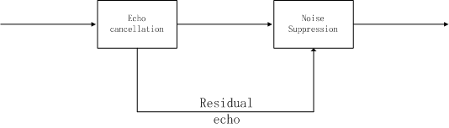
Echo cancellation performance
Moderate SNR(10dB) and echo tail length(128ms). Without residual echo suppression ERLE is 20-30dB; With residual echo suppression ERLE seems better than 40dB.
Noise suppression performance
The noise can be suppressed by adjusting the gain floor(-15dB).

Slide 3
Echo Cancellation
Echo tail length:
LMS->Frequency LMS(FLMS)->Multi-delay block Frequency LMS(MDF)
Example: Sampling Rate 8KHz; Echo tail length is 128ms(1024 points); Frame size is 16ms(128 points).
MDF scheme: N is frame size 128 points; Delay block number is 16; Equivalent tail length is 128*16=1024 points.
Adapted rate:
Sub-band, Normalization(time or frequency domain), pre-emphasis filter
VAD:
Coherence(coherence between microphone and far-end speech), two-path logic, Step size control
Scheme: MDF + Normalization & Pre-emphasis filter + Two-path logic & Step size control

Slide 4
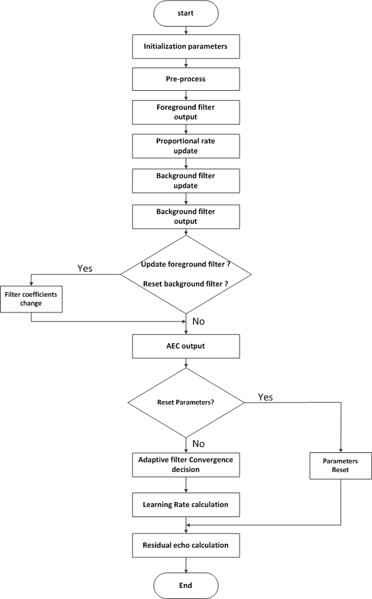

Slide 5
Noise Suppression
Noise estimation
When to update? Voice activity detection at every frequency point.
Posteriori & priori SNR estimation
Posteriori SNR is estimated every frame, priori SNR is smoothing result
Speech presence probability estimation
stable process
Gain estimation
log MMSE

Slide 6
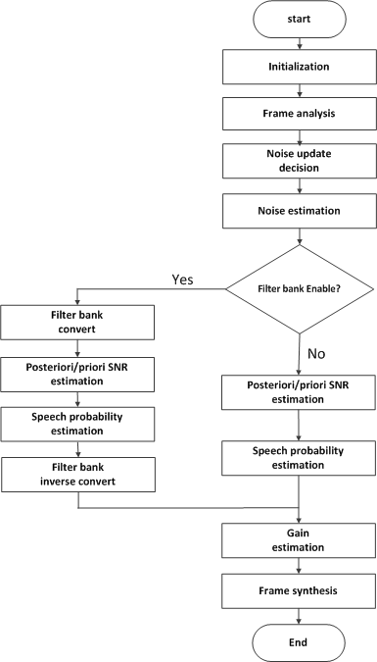

Slide 7
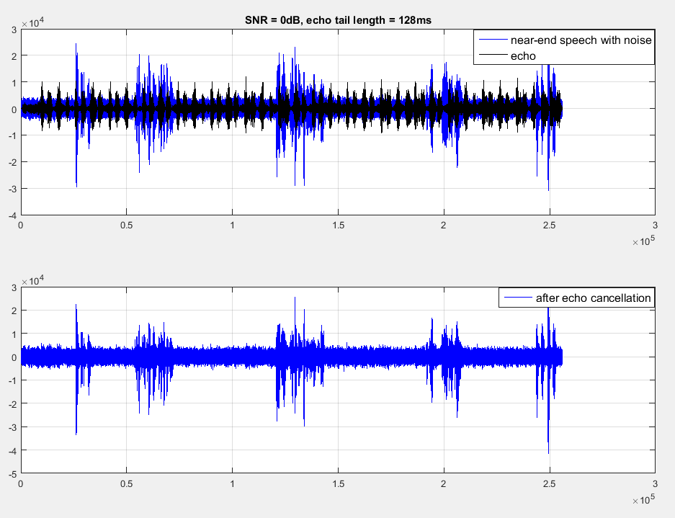
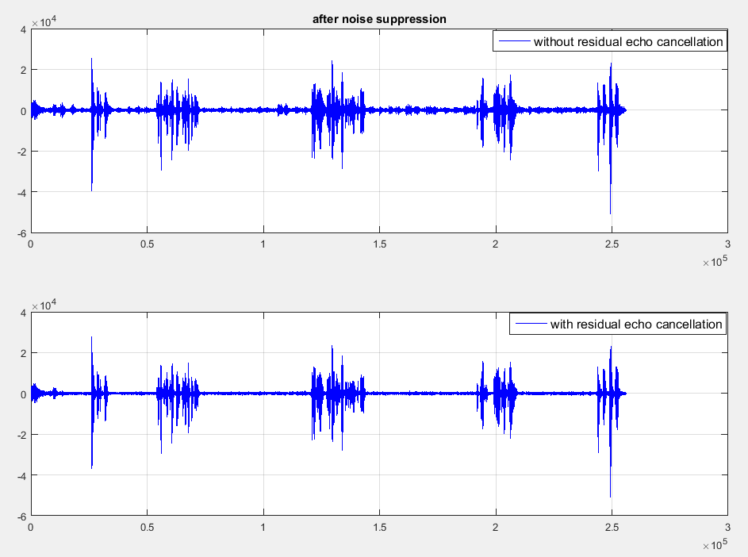
Simulation result
Case 1: SNR = 0dB, echo tail length = 128ms

Slide 8
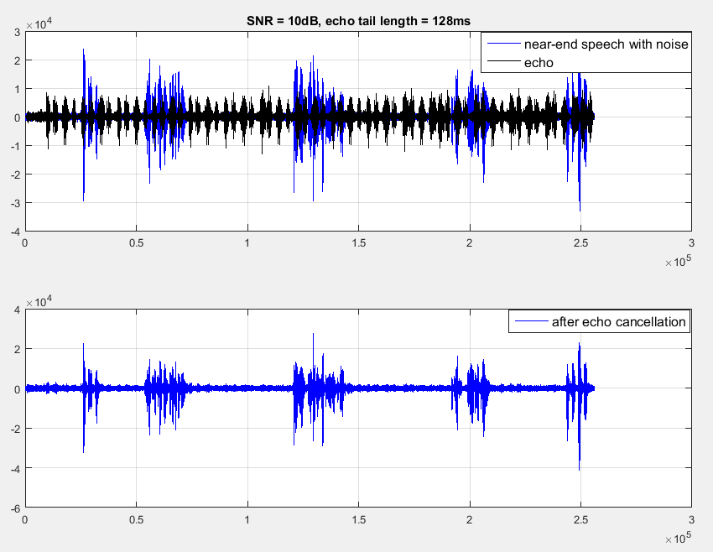
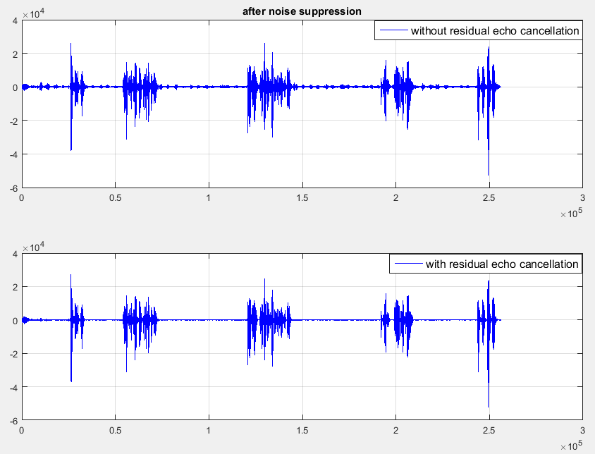
Simulation result
Case 2: SNR = 10dB, echo tail length = 128ms

Slide 9
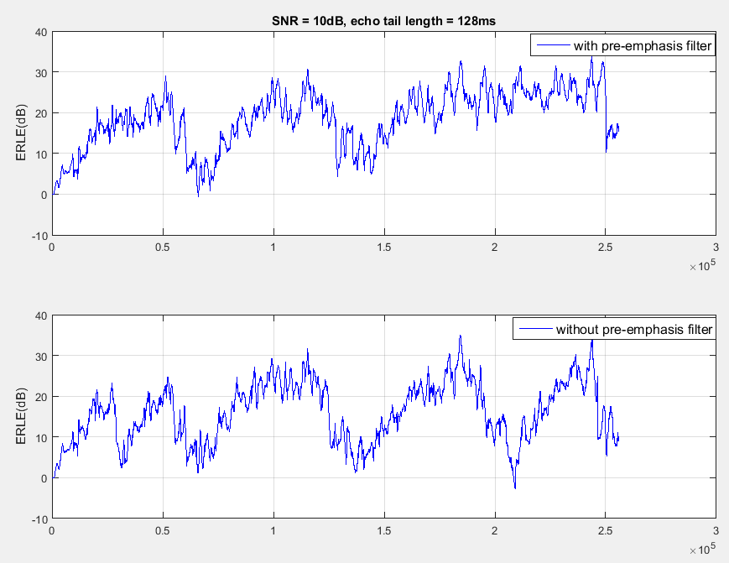
Simulation result
Case 3: SNR = 10dB, echo tail length = 128ms

